Slide 1
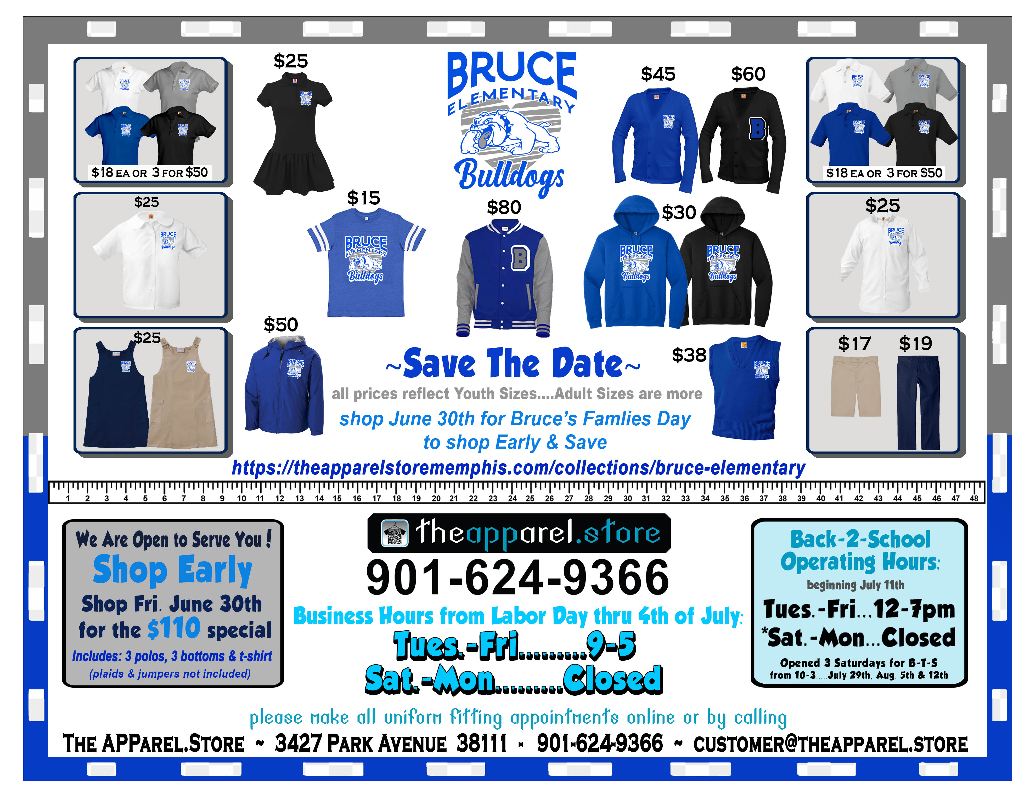
Get Your Bruce Gear!

